Slide 1

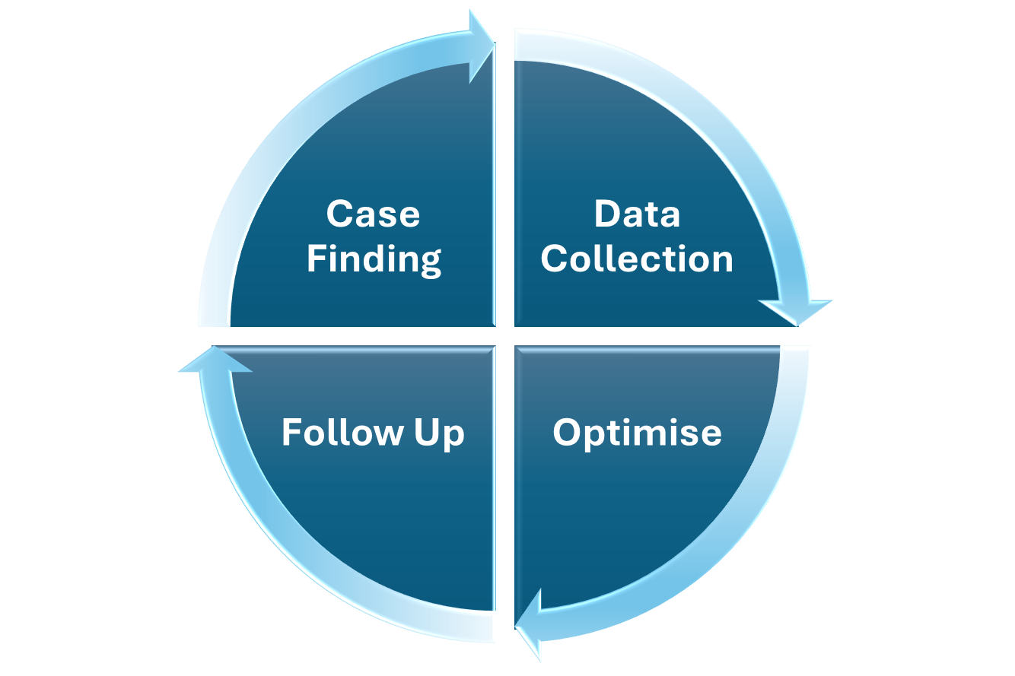
BLMK - Effective Hypertension Management in Primary Care

Slide 2
BLMK - Effective Hypertension Management in Primary Care
Rational
Controlling hypertension is a key aspect of preventing serious cardiovascular diseases such as heart attack and strokes as well as kidney failure and Dementia. Proper management of high blood pressure (BP) can significantly reduce the risk of these life-threatening conditions, making it essential to ensure that all people with hypertension are appropriately identified and treated to their target BP.
To improve patient safety and outcomes, it is essential for practices to take four key actions:
1. Case Finding
2. Data Collection
3. Optimise
4. Follow Up
These actions will not only help manage hypertension more effectively but also ensure that practices are able to claim appropriate remuneration under frameworks such as the Quality and Outcomes Framework (QOF), BLMK Primary care Framework (PCF) and the BLMK Prescribing Incentive Scheme (PIS).
This pack provides a comprehensive guide to identifying and managing people with hypertensive using SystmOne Clinical Reporting. It highlights a series of centrally published searches designed to help you quickly find people prescribed antihypertensive medications without diagnosis and suboptimal BP management to ensure they are receiving appropriate, up-to-date care. These searches support efficient case finding, accurate data collection, and effective follow-up.
The process is divided into four key areas : Case Finding, Data Collection, Medication Optimisation, and Follow-Up, with targeted searches to support each stage. A user-friendly guide is also included, offering step-by-step instructions to help practices make the most of these tools and streamline hypertension management from initial identification through to ongoing care.
Additionally, the pack contains a dedicated section with hypertension resources and guidance on the sick day rules.

Slide 3
BLMK - Effective Hypertension Management in Primary Care
Controlling hypertension is a critical aspect of preventing heart attacks, strokes, kidney failure and dementia. Management of high blood pressure (BP) to target BP can significantly reduce the risk of these life-threatening conditions, making it essential to ensure that all people with hypertension are appropriately identified and treated.
To improve patient safety and outcomes, it is essential for practices to take 4 key actions
A common issue in primary care is the failure to accurately identify and code people with hypertension, especially those who are already prescribed antihypertensive medications. This oversight can lead to missed opportunities for follow-up care, inadequate monitoring, and suboptimal treatment.
Once people with hypertension are identified, obtain accurate, up-to-date BP readings. Regular monitoring is crucial to assess current BP control, medication effectiveness, and identify issues such as non-compliance. Without these readings, clinicians cannot optimise medications or identify issues such as non-compliance or rising BP
Follow-up appointments help track progress and ensure that blood pressure remains well-controlled. They provide an opportunity to provide education, monitor for medication side effects, optimise medications, offer support on lifestyle changes, and discuss any challenges patients may face in adhering to their treatment plan.
It is essential to optimise antihypertensive medication regimens to achieve optimal BP control. The East of England Hypertension Protocol is an evidence based simplified treatment pathway that minimise the risk of side effects, helping patients achieve optimal BP control with fewer medication changes and interventions.

Slide 4
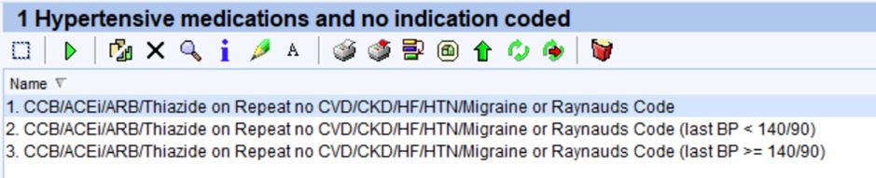
Case Finding
A common issue in primary care is the failure to accurately code people with hypertension, especially those who are already prescribed antihypertensive medications. This oversight can lead to missed opportunities for follow-up care, inadequate monitoring, and suboptimal treatment.
Why It Matters: Case finding helps practices identify uncoded people on antihypertensives and add them to the hypertension register using custom SystmOne searches. Without accurate coding, these patients may miss out on important follow-up appointments and checks that are critical for optimising their treatment.
The Risk of Missing Patients: Failure to identify and code people with hypertension can result in inadequate disease management, reduced quality of care and increased risk of complications.
Choosing the Right Clinicians: It is important to select clinicians and team members who have a good understanding of hypertension management, are confident with SystmOne searches, and are meticulous with coding and documentation. Choosing the right people for this work ensures accuracy, consistency and promotes clinical ownership of the hypertension register.
Using SystmOne Case Finding Searches and Clinical Audit to Drive Improvement:
Case finding searches have been developed and published on SystmONE to identify people prescribed antihypertensive medications but without a SNOMED code for hypertension CVD, CKD, heart failure, migraine or Raynaud’s.
“Clinical audit in selected practices of people identified by the search identified that 50% did in fact have hypertension but were not coded. Of those identified with hypertension 68% had a last BP that was at their age-appropriate treatment target. With circa 12,000 people across BLMK identified in the case finding search 6,000 uncoded hypertensive patients in BLMK. This highlights the significant value of audit in identifying missed cases, improving register accuracy, and targeting clinical follow-up more effectively”.
An audit can be carried out using the case-finding searches we have developed, providing insight into how well patients are being identified and coded. This can highlight gaps in coding practices, identify patterns (such as which clinicians may need support), and serve as a valuable learning tool. By understanding who or why coding is being missed, practices can implement targeted training and system improvements to enhance the accuracy of their hypertension registers.

Slide 5
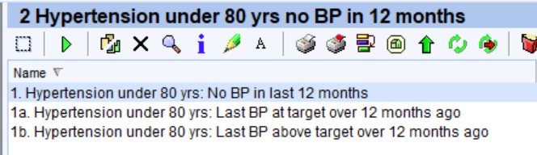
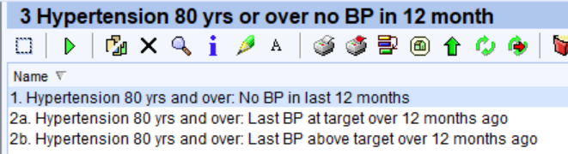
Data Collection
Once hypertensive patients are identified, obtain accurate, up-to-date BP readings. Regular monitoring is crucial to assess control, medication effectiveness, and identify issues like non-compliance or rising BP.
Why It Matters: Regular BP readings help clinicians track a patient’s response to treatment and adjust the approach as needed. These readings provide vital data that informs treatment decisions and helps clinicians identify trends in a patient’s blood pressure over time.
The Role of Protocol and Teamwork: Having a clear protocol in place ensures consistency across the practice and defines responsibilities. Trained non-clinical staff can support this work by collating and entering BP data, which is then reviewed by the appropriate clinicians for clinical decision-making. This team-based approach improves efficiency and ensures that clinicians can focus on assessment and treatment planning.
Leveraging Digital Technology: Utilising digital tools, such as remote monitoring systems, text messaging services and home BP submissions, can streamline data collection, reduce workload, and increase patient engagement. Ensuring that up-to-date readings are available without relying solely on in-person visits.
The Risk of Missing Patients: Failing to obtain accurate BP readings annually puts patients at risk of undetected uncontrolled hypertension, leading to complications such as heart attacks or strokes. Without proper monitoring, clinicians cannot optimise treatment or adjust medications, ultimately compromising long-term health outcomes.
Search 1 refers to patients who have hypertension and are under the age of 80 but have not had their blood pressure (BP) measured in the last 12 months. This group is then further divided into two categories for more specific management:
1a: These are patients who have not had their BP measured in the last 12 months, but the last recorded BP was within the target range (i.e., their blood pressure was well-controlled when it was last measured).
1b: These are patients who have not had their BP measured in the last 12 months, and the last recorded BP was not within the target range (i.e., their blood pressure was not controlled or was above the recommended levels when it was last measured).
Search 1 refers to patients who have hypertension and are over the age of 80 but have not had their blood pressure (BP) measured in the last 12 months. This group is then further divided into two categories for more specific management:
2a: These are patients who have not had their BP measured in the last 12 months, but the last recorded BP was within the target range (i.e., their blood pressure was well-controlled when it was last measured).
2b: These are patients who have not had their BP measured in the last 12 months, and the last recorded BP was not within the target range (i.e., their blood pressure was not controlled or was above the recommended levels when it was last measured).

Slide 6
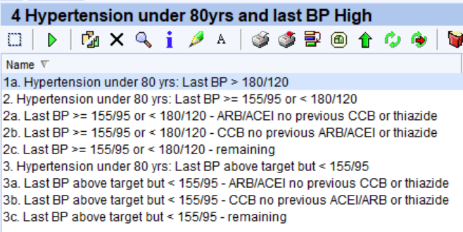
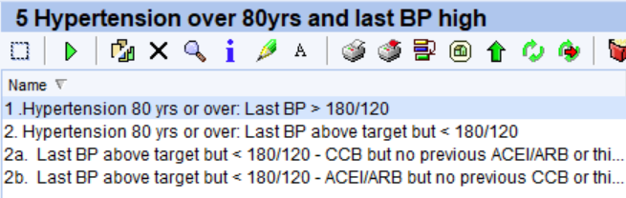
Optimise
It is essential to adjust and optimise the antihypertensive medication regimen to achieve the best possible control of the patient’s blood pressure. The East of England/BLMK Hypertension Protocol is designed to simplify treatment and minimise the risk of side effects, helping patients achieve better control over their hypertension with fewer medication changes and interventions.
Why It Matters: Optimising medication is crucial for improving treatment outcomes and reducing the risk of adverse effects. By following the BLMK protocol, healthcare professionals can ensure they are prescribing the most effective medications while keeping the number of adjustments to a minimum. This approach supports quicker BP control, often with fewer patient contacts and less ongoing monitoring—improving both patient experience and practice efficiency.
The Importance of a Standardised Protocol: Using the BLMK protocol across the whole practice ensures consistency, reduces variation in care, and supports a structured approach to hypertension management. When everyone in the practice follows the same process, patients receive equitable and evidence-based care regardless of who sees them.
Team-Based Workflow: The protocol allows for efficient workflow management by splitting tasks according to staff competence. For example, patients on no medication or only 1–2 antihypertensives can/could be reviewed and managed by pharmacists or nurses, while those with more complex needs or on multiple medications may be best managed by a GP. This team-based approach helps balance workload and ensures patients receive the right level of care.
See below search for patients needing optimisation of medication.
Use the following searches to direct workflow to the right clinician to start medication and prioritise reviews.
Searches split patient cohorts in those that have not tried CCB or ACEI/ ARB.
The Role of Lifestyle Measures: Alongside medication, lifestyle interventions—such as reducing salt intake, increasing physical activity, managing stress, and reducing alcohol consumption—play a crucial role in managing blood pressure. These should continue to be recommended to patients as part of a comprehensive approach to hypertension care.

Slide 7
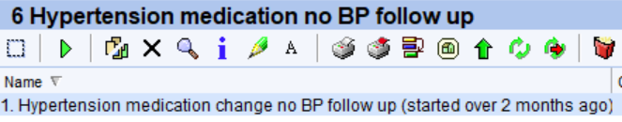
Follow up
Follow-up appointments help track progress and ensure that blood pressure remains well-controlled. They provide an opportunity to adjust medications, offer support on lifestyle changes, and discuss any challenges patients may face in adhering to their treatment plan.
Why It Matters: Safety in prescribing is crucial, and regular follow-ups ensure that any adverse effects or issues with the medication regimen are identified and addressed. Follow-ups also help clinicians tailor treatment to individual needs and maintain long-term blood pressure control.
Using Searches to Support Follow-Up: Practices can use the follow-up search not only to track patients due for review but also to audit their own protocols, checking whether patients are being followed up according to local policy and identifying those who may have slipped through. The search can highlight patients with no recent BP readings or reviews and help uncover any systemic issues or individual reasons for missed follow-up.
Efficient and Seamless Workflow: Running the follow-up search doesn’t need to be done by a clinician. Trained non-clinical staff can manage this process, identifying patients, directing work appropriately, and helping ensure patients are booked in or asked to submit BP readings. This allows the clinical team to focus on decision-making while maintaining a proactive and seamless approach to care.
The Risk of Missing Patients: Failing to follow up with hypertensive patients can lead to uncontrolled blood pressure, increasing the risk of serious complications like heart attacks, strokes, or kidney damage. It can also result in patients stopping treatment, mismanaging their medication, or experiencing unmonitored side effects—highlighting the importance of a robust, well-coordinated follow-up system.
Blending Digital and Traditional Pathways: To support all patients effectively, practices should incorporate both traditional follow-up methods and digital technology. Digital tools—such as text message reminders, online appointment booking, remote blood pressure monitoring, and patient health apps—can make it easier for patients to engage with their care, especially those who may struggle to attend in-person reviews. At the same time, it's important to maintain accessible, face-to-face pathways for patients who prefer or require more direct support. Using both approaches ensures a more inclusive, flexible system that meets the needs of diverse patient groups while reducing administrative burden and streamlining follow-up processes.

Slide 8
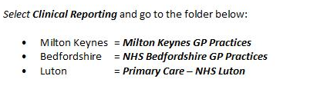
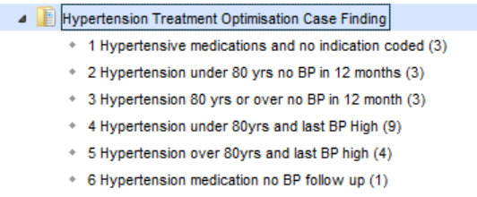
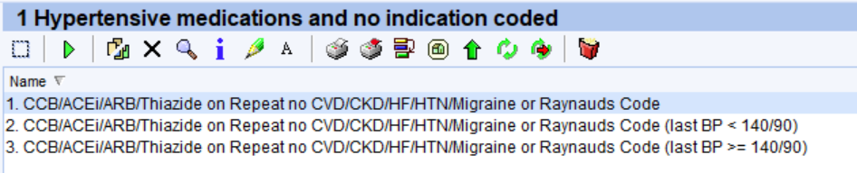

Finding the Searches on SystmOne
1. Case Finding
3. Optimise
2. Data Collection
4. Follow Up

Slide 9
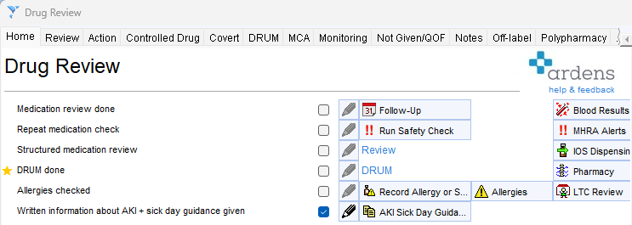
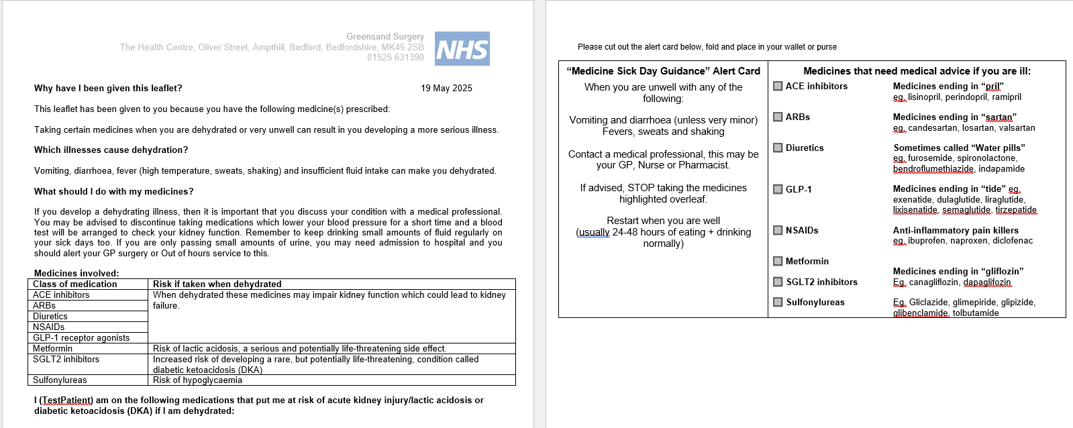
Sick Day Rules for Patients
Patients taking certain antihypertensive medications—particularly ACE inhibitors, angiotensin II receptor blockers (ARBs), and diuretics should be advised on “sick day rules” to reduce the risk of complications during episodes of acute illness.
When patients experience conditions such as vomiting, diarrhoea, fever, or reduced fluid intake, there is an increased risk of dehydration and acute kidney injury (AKI). In these situations, patients should be advised to temporarily stop taking these medications until they are well and able to eat and drink normally again, usually within 24 to 48 hours.
The risk is particularly significant for those with pre-existing kidney disease, heart failure, or older adults. Clear communication about sick day rules is essential to empower patients to recognise when to pause their medications and when to seek medical advice.
Healthcare professionals should proactively discuss and document this guidance during routine medication reviews or hypertension monitoring consultations to support safer prescribing and self-management.
As part of this process, clinicians could provide or send patients the “Sick Day Rules” letter available via Ardens templates, which offers written guidance to reinforce verbal advice. This ensures patients have clear, accessible instructions to refer to during episodes of acute illness, helping to reduce confusion and support appropriate medication management. The letter can be printed during appointments or sent electronically, and its use should be documented in the patient’s medical record.
Go to Drug Review ardens template and tick box written information about AKI +sick day guidance given
Click on AKI sick day guidance
Click on Write now and you get the letter as below which you can send or give to your patient.

Slide 10
Community Pharmacy
New Medication Service (NMS)
Consider informing patient regarding NMS service offered by community pharmacies if patient has been started on new therapy to manage hypertension.
Community pharmacy hypertension case finding
The NHS Community Pharmacy Blood Pressure Check Service plays a vital role in the early identification and prevention of cardiovascular disease (CVD). By making blood pressure (BP) checks more accessible through community pharmacies, the service supports a proactive approach to improving population health and reducing the burden of undiagnosed hypertension. Under this service, community pharmacists offer free, opportunistic blood pressure checks to adults who visit the pharmacy and provide consent.
This initiative particularly targets individuals who:
Aged 40 years or older
Have not previously been diagnosed with hypertension or related cardiovascular conditions
Have not had their blood pressure measured by a healthcare professional within the past six months.
If an initial blood pressure reading is elevated, the pharmacist may offer the patient Ambulatory Blood Pressure Monitoring (ABPM) to confirm a diagnosis of hypertension in line with clinical guidelines.
In addition to opportunistic case finding, general practices can refer patients to participating community pharmacies for:
A clinic-based blood pressure measurement, or
24-hour ABPM, where clinically appropriate.
Referred patients may include those with a known diagnosis of hypertension who require ongoing monitoring or assessment. This collaborative model between primary care and community pharmacy enhances access, reduces workload pressures in GP practices, and supports timely diagnosis and management of hypertension.
Referral form to Community Pharmacy: SystmONE template link
Further information on the service can be found here
The Shape atlas can support practices to identify Community Pharmacies offering the service, see guidance.

Slide 11
Resources
Clinical Resources to support healthcare professionals
East of England Protocols for the management of hypertension - NHS-EoE-Hypertension-Protocols-v200225.pdf
NICE Guideline Hypertension in adults: diagnosis and management - Overview | Hypertension in adults: diagnosis and management | Guidance | NICE
NICE CKS Hypertension March 2025 - Hypertension | Health topics A to Z | CKS | NICE
BNF Hypertension Treatment summaries - Hypertension | Treatment summaries | BNF | NICE
Training to support healthcare professionals
UCL Partners
CVD Resources: CVD resources – UCLPartners
CPPE – Hypertension training for Pharmacists
Hypertension (cppe.ac.uk)
E-learning for healthcare – Hypertension programme
Hypertension – elearning for healthcare (e-lfh.org.uk)
Patient Information
Patient-friendly information : Hypertension resources – for Patients

Slide 12
BLMK - Effective Hypertension Management in Primary Care
Conclusion
Effective hypertension management requires a comprehensive approach involving accurate identification, data collection, treatment optimisation, and follow-up.
By using the BLMK protocol, practices can ensure faster, more consistent BP control while reducing unnecessary visits and treatment changes.
Incorporating both digital and traditional methods maximizes patient engagement and supports all patients in managing their hypertension effectively.
With a clear protocol and team-based approach, practices can deliver safe, efficient, and high-quality care, improving long-term outcomes for hypertensive patients.

